Slide 1
Advanced Data Structures for AI
Week 4 – Graphs: Strongly Connected Components

Slide 2
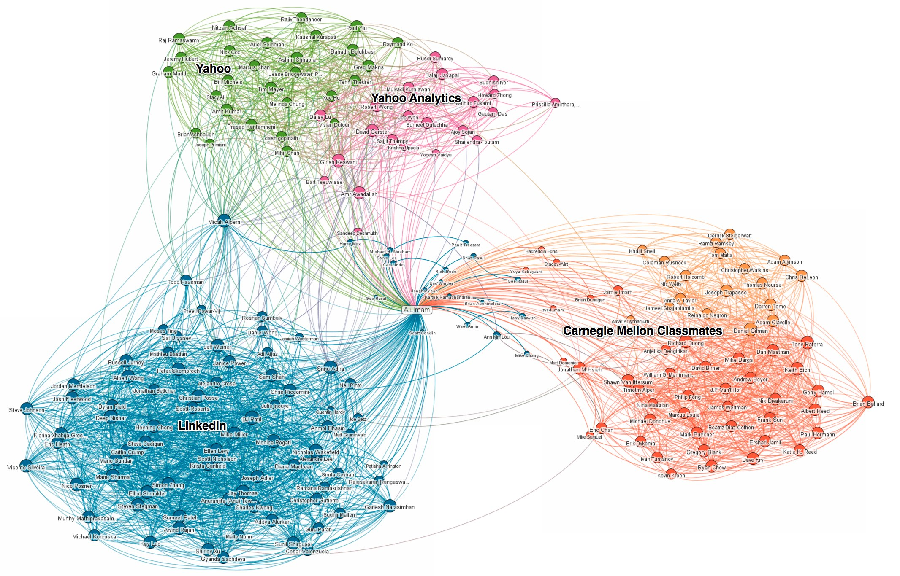
Graphs: Strongly Connected Components
Image Credit: Linkedin Official Blog

Slide 3
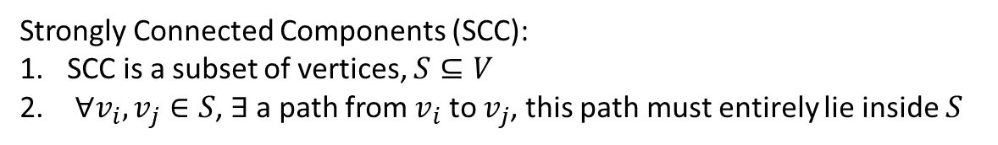
Graphs: Strongly Connected Components
Definition
Given a directed graph G
G
Strongly Connected Components (SCC):
SCC is a subset of vertices, $S⊆V$
$∀v_{i}, v_{j}∈S$, $∃$ a path from $v_{i}$ to $v_{j}$, this path must entirely lie inside $S$
4
3
5
2
1
8
Are these subsets SCCs?
{2, 3, 4, 5}
{7, 9}
{4, 6}
{2, 3, 4, 5, 6}
6
9
7

Slide 4
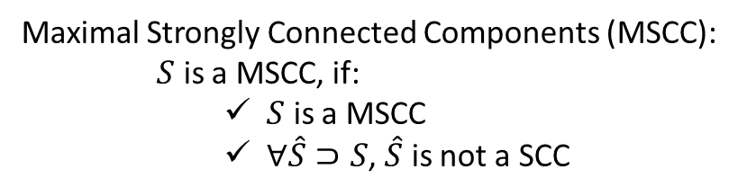
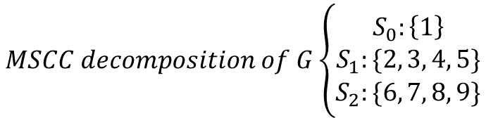
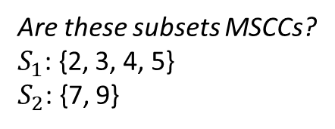
Graphs: Strongly Connected Components
Definition
Given a directed graph G
Maximal Strongly Connected Components (MSCC):
$S$ is a MSCC, if:
$S$ is a MSCC
$∀\hat{S}⊃S$, $\hat{S}$ is not a SCC
G
4
3
5
2
1
Are these subsets MSCCs?
$S_{1}$: {2, 3, 4, 5}
$S_{2}$: {7, 9}
8
6
9
trivial MSCC
7
$$MSCC decomposition of G\left\{\begin{aligned}S_{0}:\left\{1\right\} \\ S_{1}:\{2, 3, 4, 5\} \\ S_{2}:\{6, 7, 8, 9\}\end{aligned}\right.$$

Slide 5
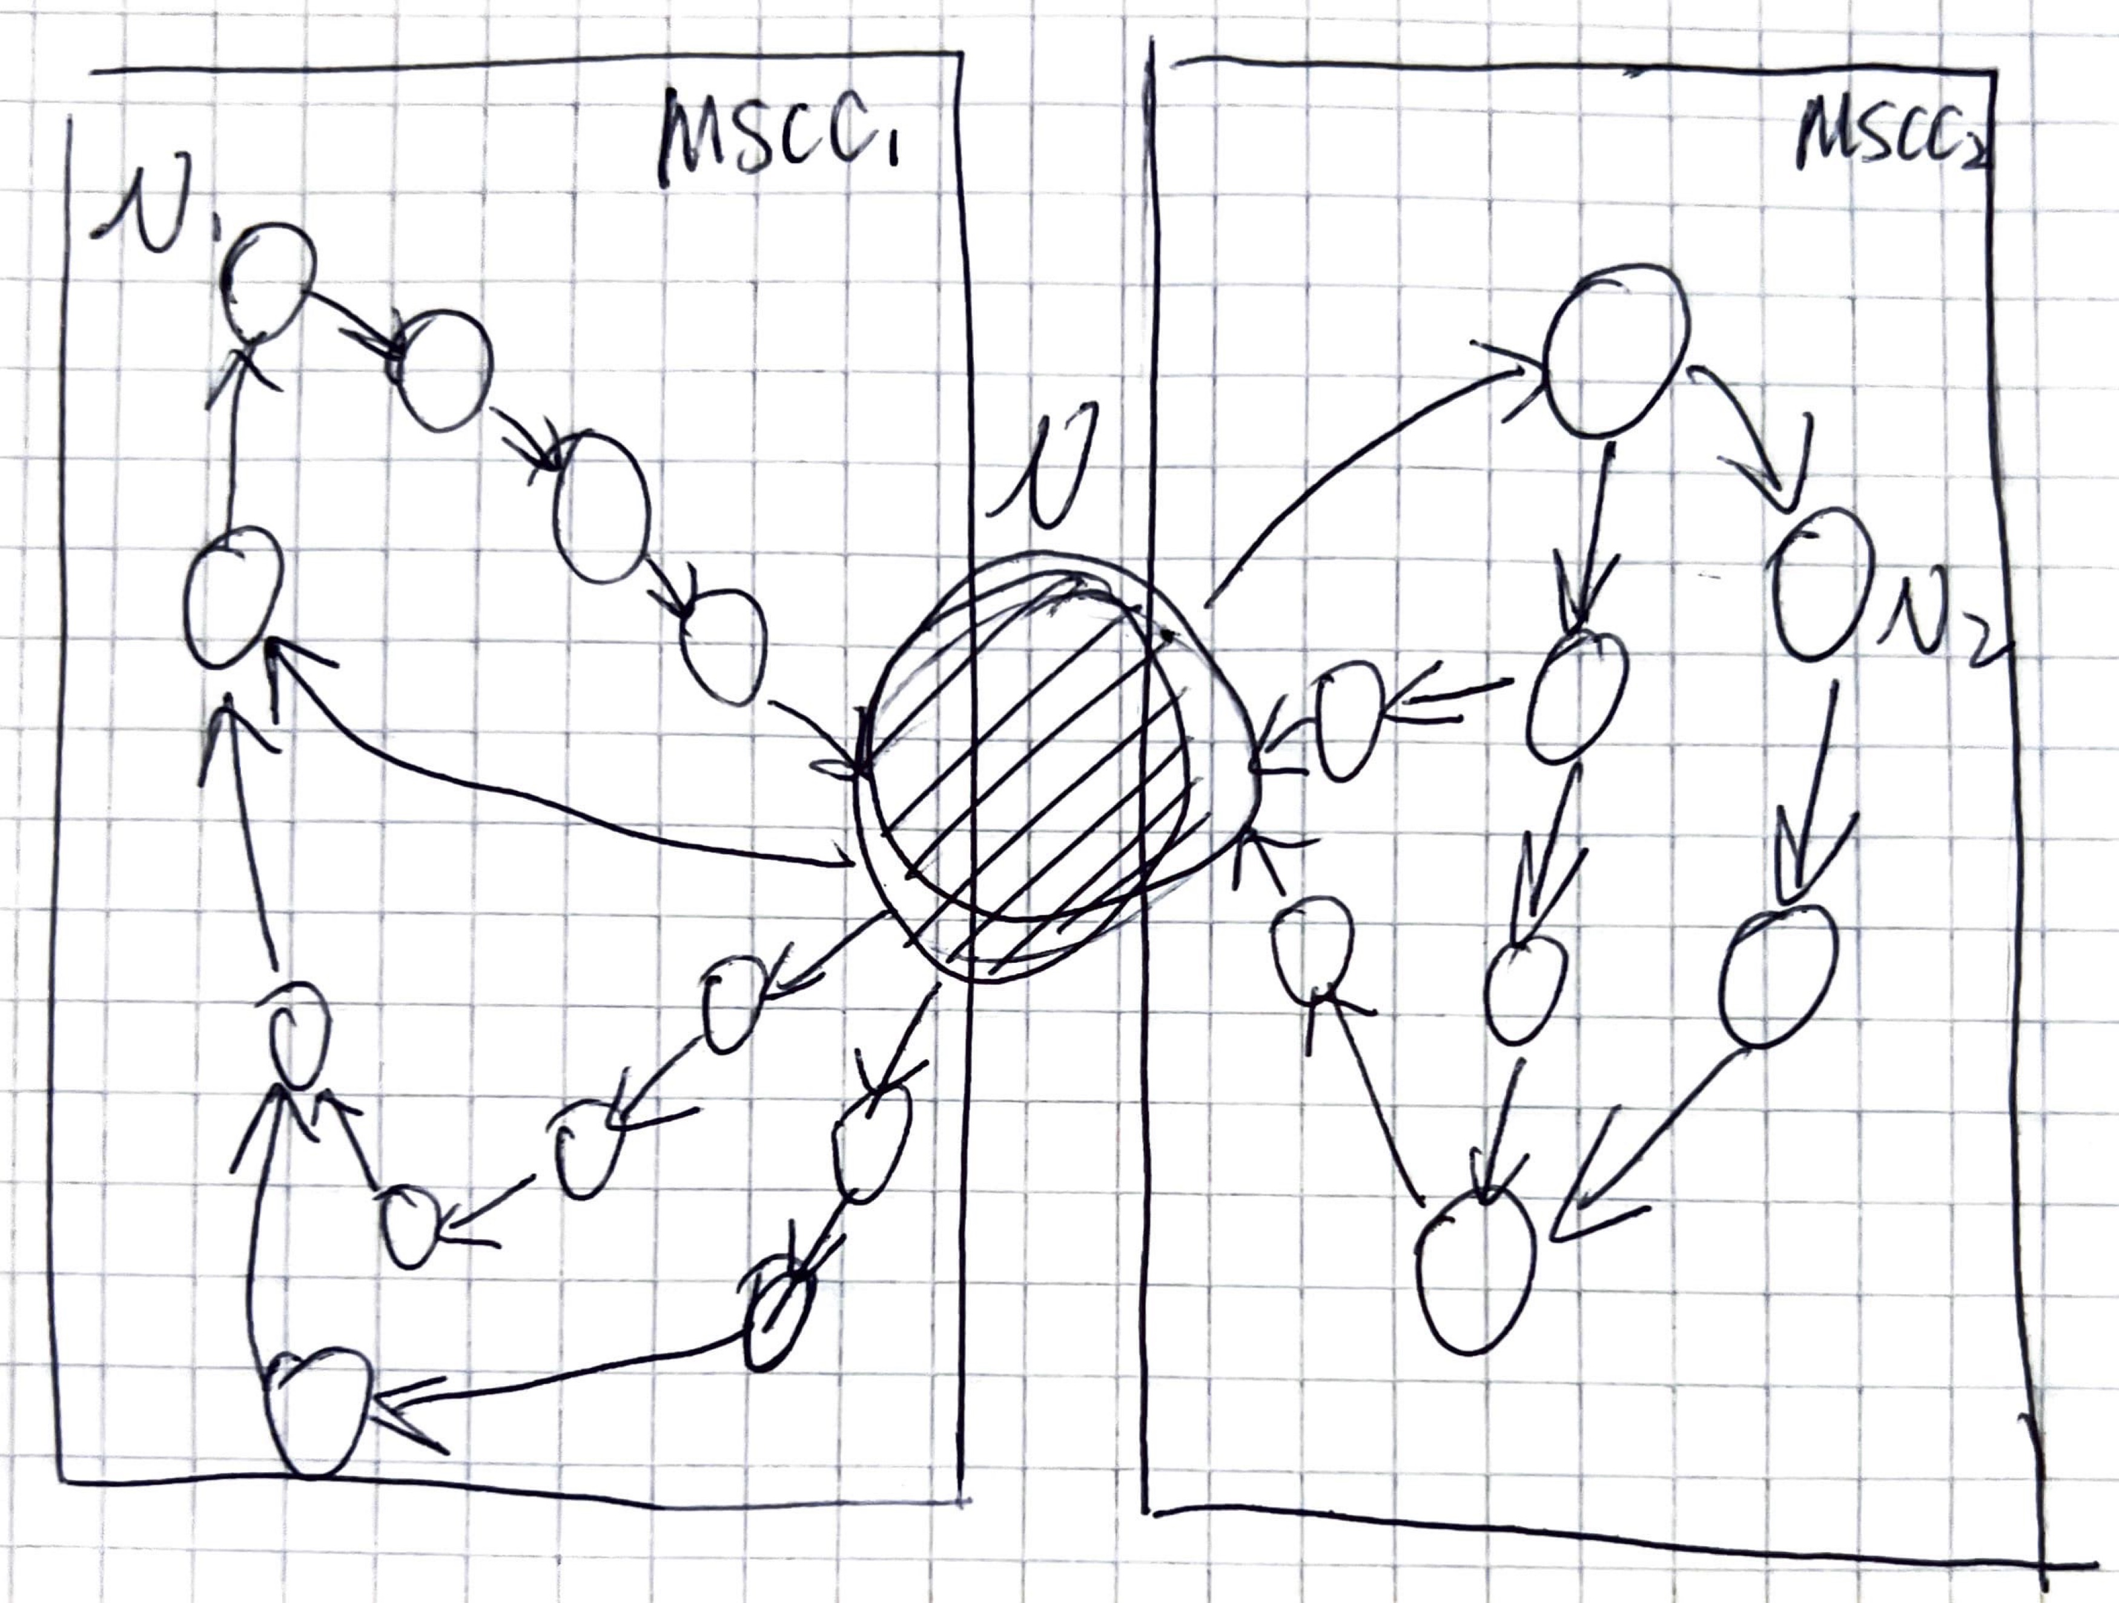
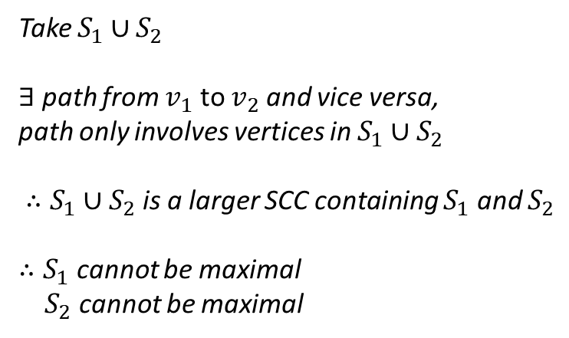
Graphs: Strongly Connected Components
Properties
Given a directed graph G
1. $S_{1}$ and $S_{2}$ are two different MSCCs of G, then $S_{1}⋂S_{2}=∅$
G
4
Take $S_{1}∪S_{2}$
$∃$ path from $v_{1}$ to $v_{2}$ and vice versa,
path only involves vertices in $S_{1}∪S_{2}$
$∴S_{1}∪S_{2}$ is a larger SCC containing $S_{1}$ and $S_{2}$
$∴S_{1}$ cannot be maximal
$S_{2}$ cannot be maximal
3
5
2
1
8
6
9
trivial MSCC
7
contradiction
$$S_{0}:\left\{1\right\}{∪S}_{1}:\left\{2, 3, 4, 5\right\}{∪S}_{2}:\left\{6, 7, 8, 9\right\}=V$$

Slide 6



Graphs: Strongly Connected Components
Properties
Given a directed graph G
1. $S_{1}$ and $S_{2}$ are two different MSCCs of G, then $S_{1}⋂S_{2}=∅$
G
4
2. MSCC Supergraph is a directed acyclic graph
3
5
2
1
$$S_{2}:\{2,3,4,5\}$$
8
6
9
Supergraph
trivial MSCC
$$S_{1}:\{1\}$$
7
$$S_{3}:\{6,7,8,9\}$$

Slide 7

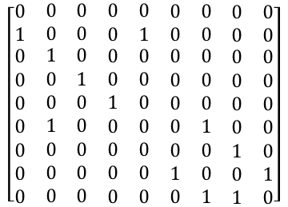
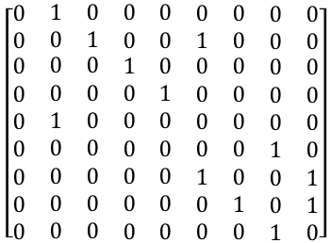


Graphs: Strongly Connected Components
Properties
Given a directed graph G
1. $S_{1}$ and $S_{2}$ are two different MSCCs of G, then $S_{1}⋂S_{2}=∅$
G
$$G^{T}$$
4
2. MSCC Supergraph is a directed acyclic graph
3
5
3. The reverse graph $G^{T}$ has the same MSCCs as G
2
1
8
9
G
$$G^{T}$$
6
$$\left[\begin{matrix}\begin{aligned}0 \\ 0\end{aligned} & \begin{aligned}\begin{matrix}1 & 0 & \begin{matrix}0 & 0 & \begin{matrix}0 & 0 & \begin{matrix}0 & 0\end{matrix}\end{matrix}\end{matrix}\end{matrix} \\ \begin{matrix}0 & 1 & \begin{matrix}0 & 0 & \begin{matrix}1 & 0 & \begin{matrix}0 & 0\end{matrix}\end{matrix}\end{matrix}\end{matrix}\end{aligned} \\ \begin{aligned}0 \\ 0 \\ 0 \\ 0 \\ 0 \\ 0 \\ 0\end{aligned} & \begin{aligned}\begin{matrix}0 & 0 & \begin{matrix}1 & 0 & \begin{matrix}0 & 0 & \begin{matrix}0 & 0\end{matrix}\end{matrix}\end{matrix}\end{matrix} \\ \begin{matrix}0 & 0 & \begin{matrix}0 & 1 & \begin{matrix}0 & 0 & \begin{matrix}0 & 0\end{matrix}\end{matrix}\end{matrix}\end{matrix} \\ \begin{matrix}1 & 0 & \begin{matrix}0 & 0 & \begin{matrix}0 & 0 & \begin{matrix}0 & 0\end{matrix}\end{matrix}\end{matrix}\end{matrix} \\ \begin{matrix}0 & 0 & \begin{matrix}0 & 0 & \begin{matrix}0 & 0 & \begin{matrix}1 & 0\end{matrix}\end{matrix}\end{matrix}\end{matrix} \\ \begin{matrix}0 & 0 & \begin{matrix}0 & 0 & \begin{matrix}1 & 0 & \begin{matrix}0 & 1\end{matrix}\end{matrix}\end{matrix}\end{matrix} \\ \begin{matrix}0 & 0 & \begin{matrix}0 & 0 & \begin{matrix}0 & 1 & \begin{matrix}0 & 1\end{matrix}\end{matrix}\end{matrix}\end{matrix} \\ \begin{matrix}0 & 0 & \begin{matrix}0 & 0 & \begin{matrix}0 & 0 & \begin{matrix}1 & 0\end{matrix}\end{matrix}\end{matrix}\end{matrix}\end{aligned}\end{matrix}\right]$$
$$\left[\begin{matrix}\begin{aligned}0 \\ 1\end{aligned} & \begin{aligned}\begin{matrix}0 & 0 & \begin{matrix}0 & 0 & \begin{matrix}0 & 0 & \begin{matrix}0 & 0\end{matrix}\end{matrix}\end{matrix}\end{matrix} \\ \begin{matrix}0 & 0 & \begin{matrix}0 & 1 & \begin{matrix}0 & 0 & \begin{matrix}0 & 0\end{matrix}\end{matrix}\end{matrix}\end{matrix}\end{aligned} \\ \begin{aligned}0 \\ 0 \\ 0 \\ 0 \\ 0 \\ 0 \\ 0\end{aligned} & \begin{aligned}\begin{matrix}1 & 0 & \begin{matrix}0 & 0 & \begin{matrix}0 & 0 & \begin{matrix}0 & 0\end{matrix}\end{matrix}\end{matrix}\end{matrix} \\ \begin{matrix}0 & 1 & \begin{matrix}0 & 0 & \begin{matrix}0 & 0 & \begin{matrix}0 & 0\end{matrix}\end{matrix}\end{matrix}\end{matrix} \\ \begin{matrix}0 & 0 & \begin{matrix}1 & 0 & \begin{matrix}0 & 0 & \begin{matrix}0 & 0\end{matrix}\end{matrix}\end{matrix}\end{matrix} \\ \begin{matrix}1 & 0 & \begin{matrix}0 & 0 & \begin{matrix}0 & 1 & \begin{matrix}0 & 0\end{matrix}\end{matrix}\end{matrix}\end{matrix} \\ \begin{matrix}0 & 0 & \begin{matrix}0 & 0 & \begin{matrix}0 & 0 & \begin{matrix}1 & 0\end{matrix}\end{matrix}\end{matrix}\end{matrix} \\ \begin{matrix}0 & 0 & \begin{matrix}0 & 0 & \begin{matrix}1 & 0 & \begin{matrix}0 & 1\end{matrix}\end{matrix}\end{matrix}\end{matrix} \\ \begin{matrix}0 & 0 & \begin{matrix}0 & 0 & \begin{matrix}0 & 1 & \begin{matrix}1 & 0\end{matrix}\end{matrix}\end{matrix}\end{matrix}\end{aligned}\end{matrix}\right]$$
trivial MSCC
7
Adjacency Matrix

Slide 8





Graphs: Strongly Connected Components
Complexity?
Step 1: 𝝝(|V|+|E|)
Step 2: 𝝝(|V|+|E|)
Reverse Graph: 𝝝(|V|+|E|)
Algorithm
Given a directed graph G
1. Run DFS on $G$
G
$$G^{T}$$
2. Reverse the graph $G$ to $G^{T}$
4
2. Run DFS on $G^{T}$ in the descending order of finish times
3
5
 | d | f
1 | 1 | 18
2 | 2 | 17
3 | 3 | 8
4 | 4 | 7
5 | 5 | 6
6 | 9 | 16
7 | 11 | 14
8 | 10 | 15
9 | 12 | 13
2
1
2
6
8
7
9
3
4
5
1
8
Descending order of finish times
6
9
{1}
{2, 3, 4, 5}
{6, 7, 8, 9}
7
Topological sorting supergraph
$$S_{1}$$
$$S_{2}$$
$$S_{3}$$

Slide 9
Graphs
Week 4 – Optional tasks:
Write down the bfs_visit() function for your UndirectedGraph class used for create and traverse the graph
Change the UndirectedGraph class to directedGraph class and revise the dfs_visit and bfs_visit according to the edge direction
Search for an example of using BFS or DFS – e.g. Maze-solving algorithm
Quick reminder:
Week 3 programming task is due on this Sunday (29th October)
Week 4 programming task is due on next Sunday (5th November)

